Slide 1
mehendi
dev and Anjali
PPT for Event ID: 7
Date: 2025-02-01

Slide 2
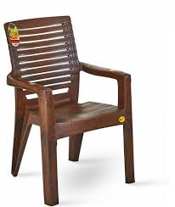
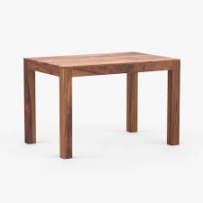
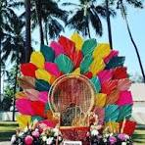
Category: Furniture
chair
table
chair
₹2000.00 x 20
₹200.00 x 20
₹500.00 x 5

Slide 3
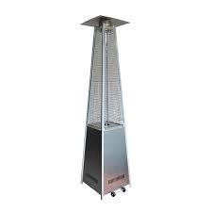
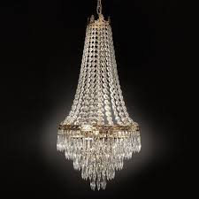
Category: Decor
Pyramid heater
Jhoomar
₹3000.00 x 20
₹2000.00 x 5

Slide 4

Category: Services
Russian Dancer
₹6000.00 x 20

Slide 5
Quotation Summary
Total Cost: ₹236500.00

